Slide 1
TOSCA
Topology and Orchestration Specification for Cloud Applications

Slide 2
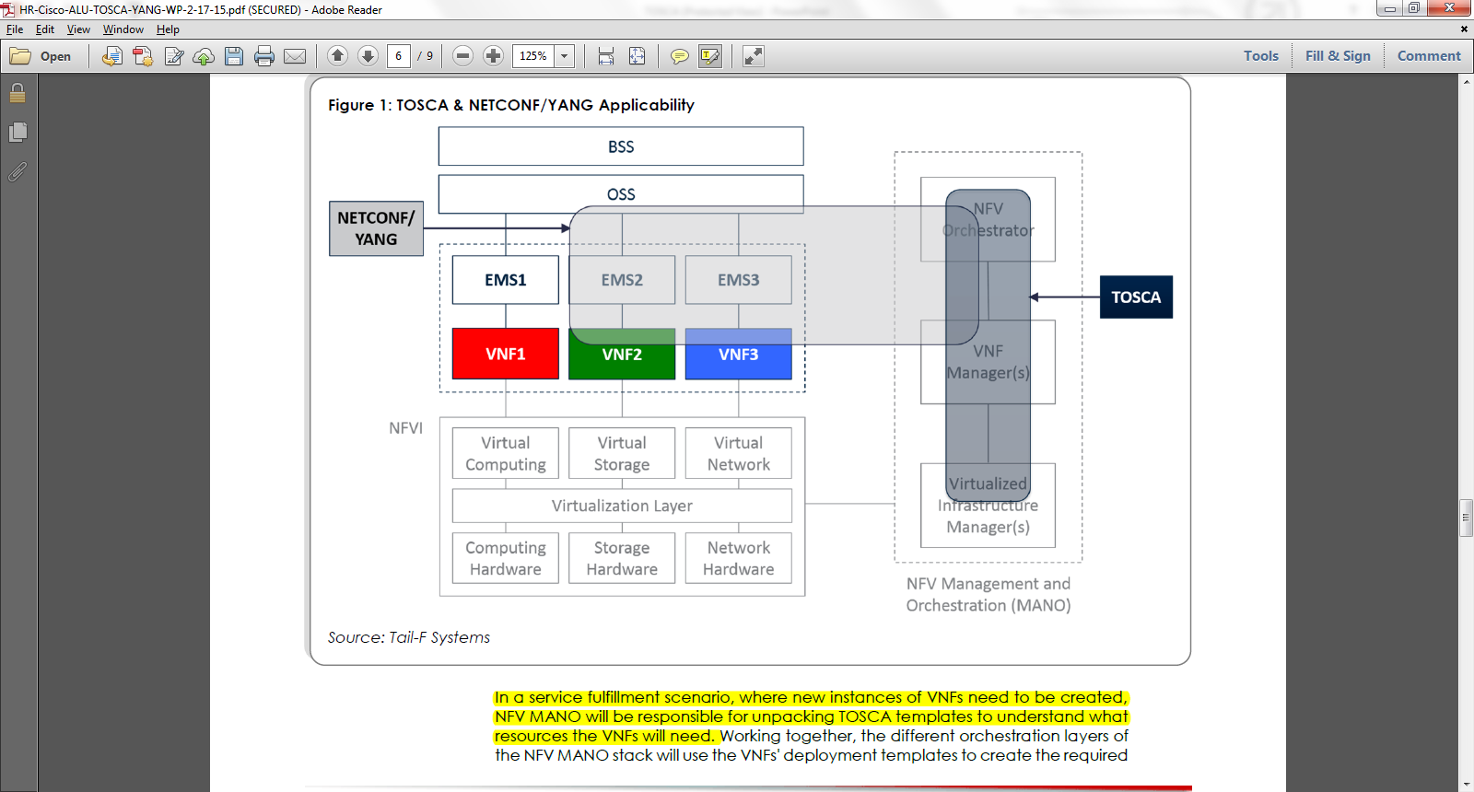
TOSCA, NETCONF/YANG Applicability

Slide 3
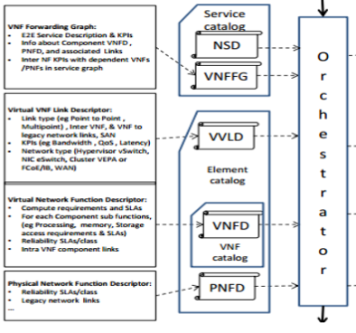
Deployment Templates
The deployment template in NFV fully describes the attributes and requirements necessary to realize such a Network Service.
The deployment template for a network service in NFV is called a network service descriptor (NSD).
A VNF Descriptor (VNFD) is a deployment template which describes a VNF in terms of its deployment and operational behavior requirements.

Slide 4
Deployment Templates
A VNF Forwarding Graph Descriptor (VNFFGD) is a deployment template which describes a topology of the Network Service or a portion of the Network Service, by referencing VNFs and PNFs and Virtual Links that connect them.
A Virtual Link Descriptor (VLD) is a deployment template which describes the resource requirements that are needed for a link between VNFs, PNFs and endpoints of the Network Service, which could be met by various link options that are available in the NFVI.

Slide 5
Instantiation
The NFVO receives all descriptors and on-boards to the catalogues.
NSD, VNFFGD, and VLD are “on-boarded” into a NS Catalogue.
VNFD is on-boarded in a VNF Catalogue, as part of a VNF Package.
At the instantiation procedure, the sender (operator) sends an instantiation request which contains instantiation input parameters that are used to customize a specific instantiation of a network service or VNF.
Instantiation input parameters contain information that identifies a deployment flavor to be used and those parameters used for the specific instance.

Slide 6
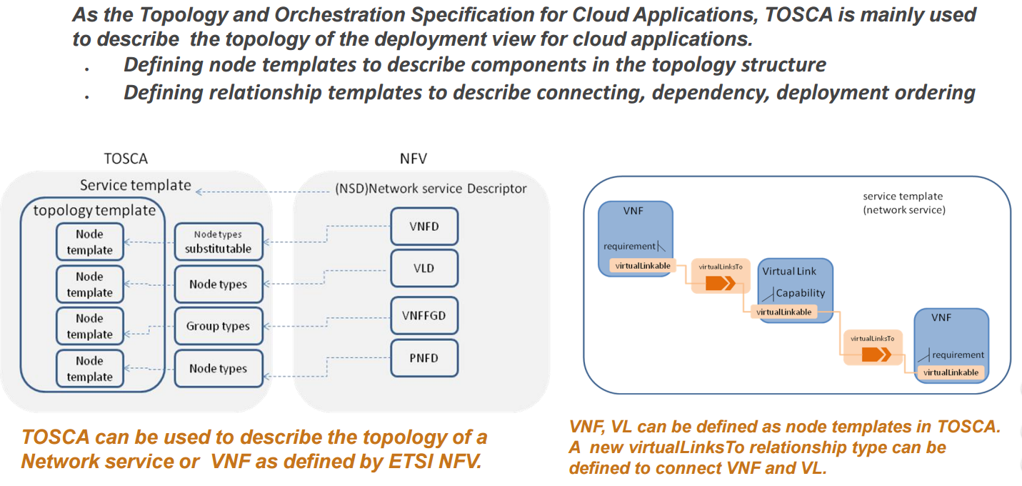
Topology

Slide 7
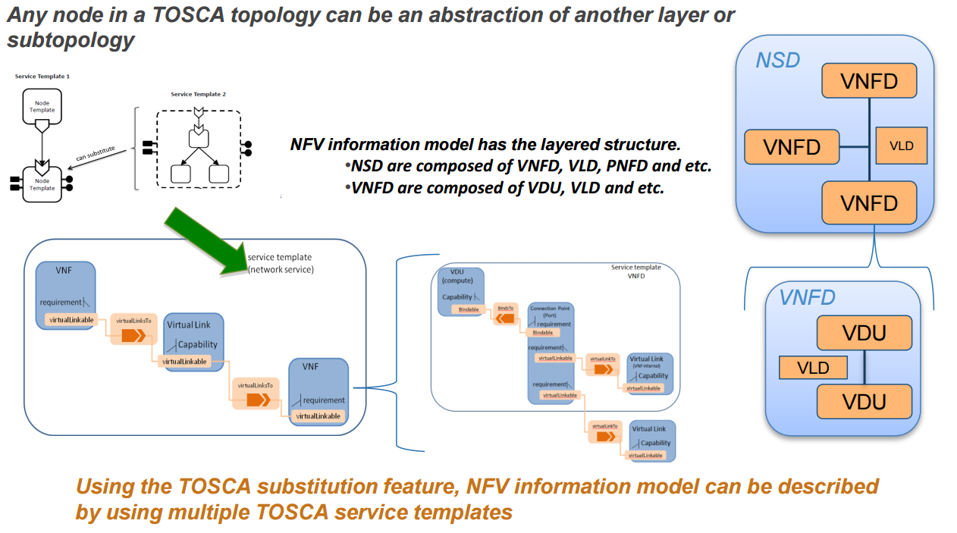
Composition

Slide 8
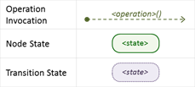
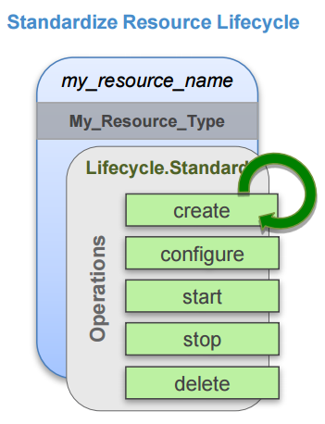
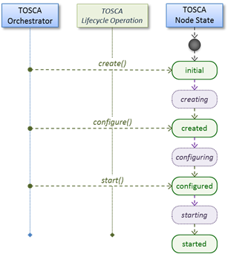
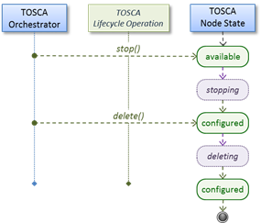
Lifecycle
Normal node startup sequence diagram
Normal node shutdown sequence diagram.

Slide 9
YAML
YAML Ain't Markup Language
language used to write Tosca template
human friendly, with a syntax much easier to read and edit than XML.

Slide 10
Examples

Slide 11
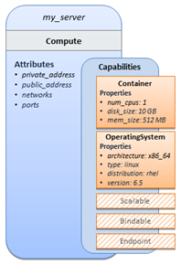
Example 1 - TOSCA Simple "Hello World"
tosca_definitions_version: tosca_simple_yaml_1_0 # namespace description: Template for deploying a single server with predefined properties. topology_template: node_templates: # optional list of node template definitions for the Topology template my_server: type: tosca.nodes.Compute capabilities: # capabilities of the node template ‘my_server’ # Host container properties host: properties: # properties needed – for host- when Compute node is instantiated num_cpus: 1 disk_size: 10 GB mem_size: 4096 MB # Guest Operating System properties os: properties: # properties needed – for the host OS- when Compute node is instantiated # host Operating System image properties architecture: x86_64 type: linux distribution: rhel version: 6.5

Slide 12
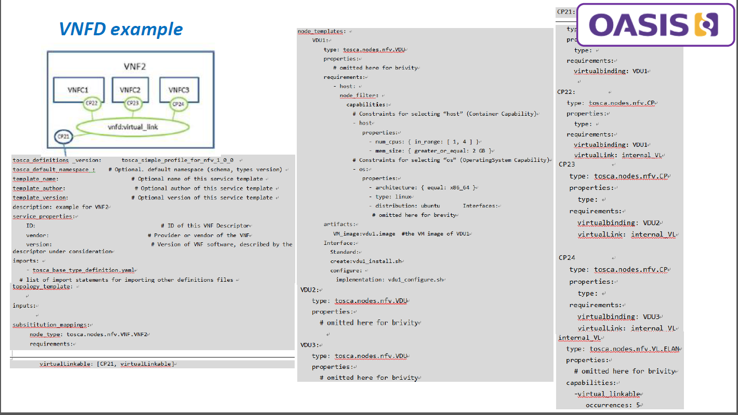

Slide 13
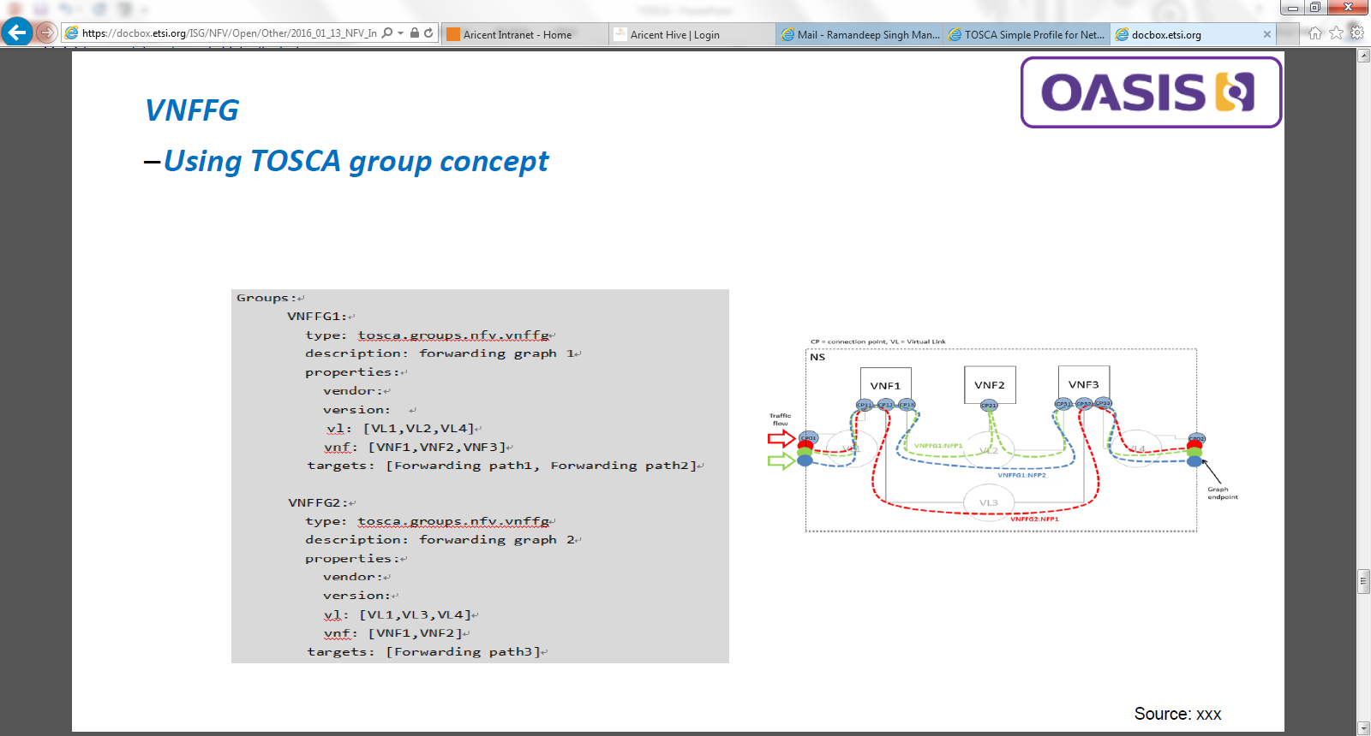

Slide 14
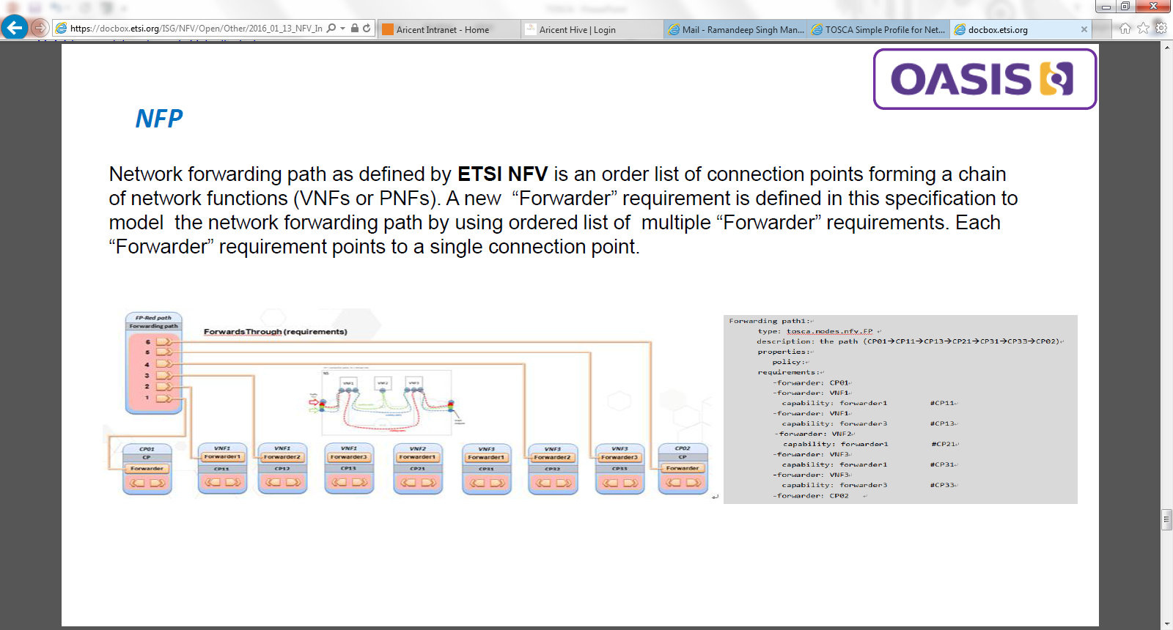

Slide 15
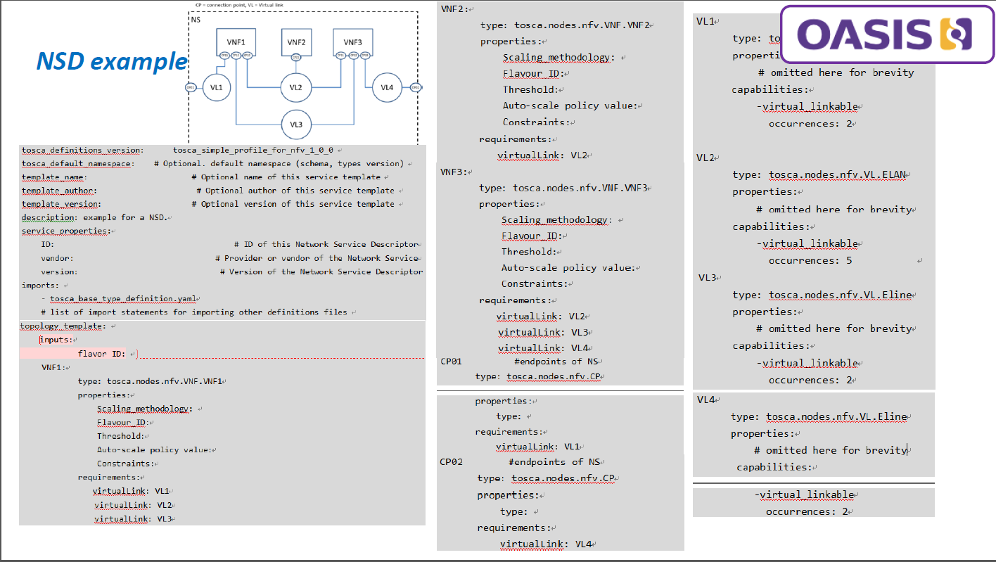

Slide 16
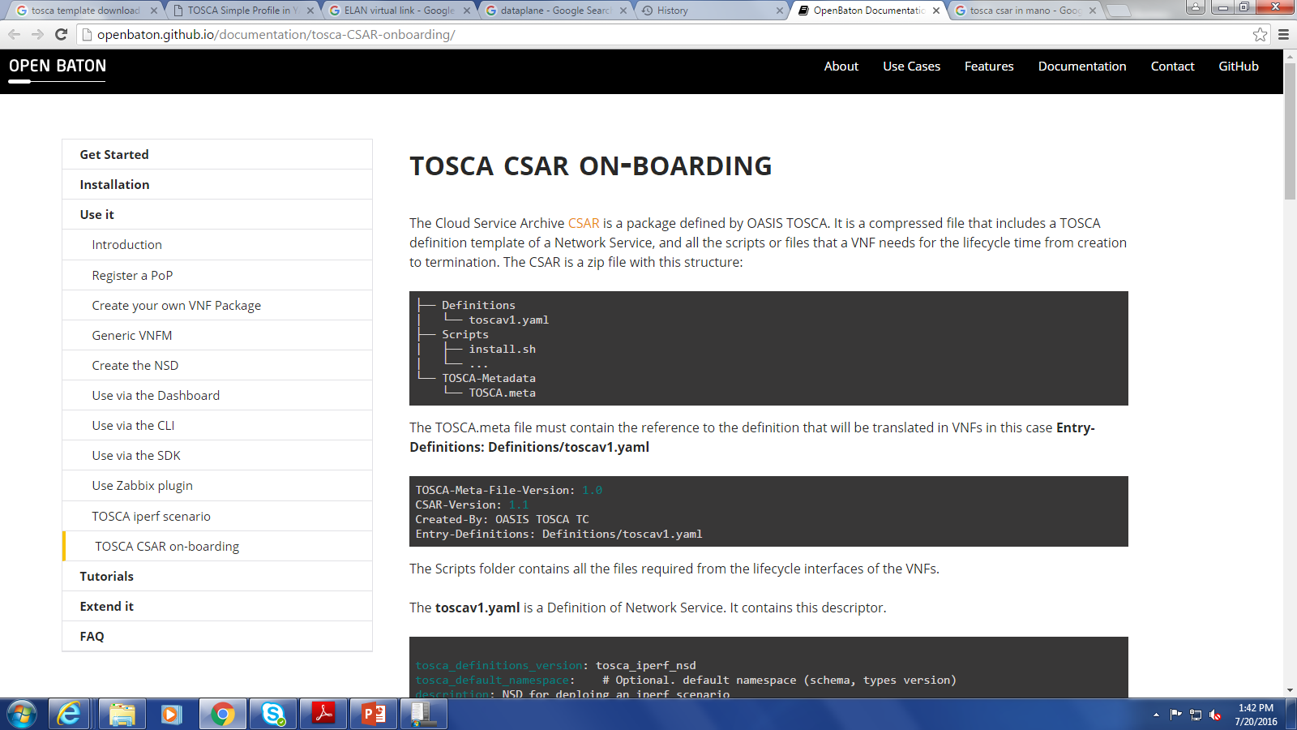
TOSCA CSAR(Cloud Service ARchive)
The Cloud Service Archive CSAR is a package defined by OASIS TOSCA. It is a compressed file that includes a TOSCA definition template of a Network Service, and all the scripts or files that a VNF needs for the lifecycle time from creation to termination. The CSAR is a zip file with this structure:

Slide 17
References:
http://docs.oasis-open.org/tosca/tosca-nfv/v1.0/csd03/tosca-nfv-v1.0-csd03.html#_Toc447714690
http://docs.oasis-open.org/tosca/TOSCA-Simple-Profile-YAML/v1.0/cs01/TOSCA-Simple-Profile-YAML-v1.0-cs01.html

Slide 18
Thank you !

